Slide 1



http://www.free-powerpoint-templates-design.com
FIFA 2019 Analysis and Modelling
By Anirban Pal

Slide 2

Agenda
Agenda Style
Background
01
Get a modern PowerPoint Presentation that is beautifully designed. I hope and I believe that this Template will your Time.
01
Background
Data Cleansing
02
03
Data Cleansing
Get a modern PowerPoint Presentation that is beautifully designed. I hope and I believe that this Template will your Time.
Data Exploration
03
04
Data Exploration
Get a modern PowerPoint Presentation that is beautifully designed. I hope and I believe that this Template will your Time.
Model Analysis
05
04
Model Analysis
Get a modern PowerPoint Presentation that is beautifully designed. I hope and I believe that this Template will your Time.

Slide 3


Background
What this project is

Slide 4
Background
The dataset for this project is collected from
https://www.kaggle.com/karangadiya/fifa19/version/4#
The Fédération Internationale de Football Association or FIFA is a non-profit organization which
describes itself as an international governing body of association football, fútsal, beach soccer, and
efootball. It is the highest governing body of football. (Wikipedia)
The intention of this project is to explore the players dataset as a whole, as well as discover the significance of different player attributes and how they impact a plyers performance, rating and potential.
Data originally scraped from https://sofifa.com/
Includes all 18,207 players of FIFA.

Slide 5
Data Cleansing
Preparing data for analysis

Slide 6
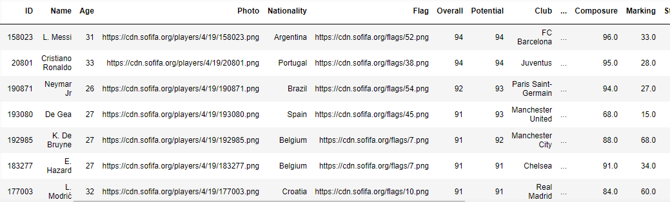
Raw Data
The raw data is available as a flat file with 89 attributes.
Sample of attributes and observations from the raw data

Slide 7
Data Cleansing Steps
Remove redundant columns
Create new columns as needed
Currency standardization
Columns without any analytic significance (e.g. URL) are removed
One field is split into multiple to create meaningful attributes
All currency fields are standardized to thousands of Euro
1
2
3
4
5
Handle null values
Unit conversion
Fill as much null values as possible using mean (continuous) or mode (categorical).
Height and weight is converted to respective uniform units.

Slide 8
Data Exploration
Finding insights

Slide 9
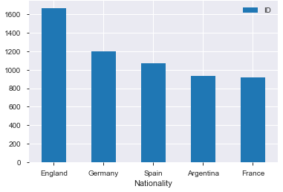
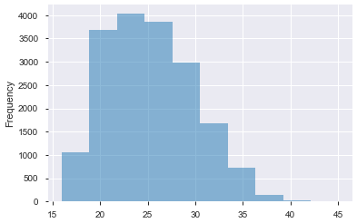
Data Exploration
Which are the major football playing nations?
This analysis is done by counting distinct players from each nation.
Which are the richest clubs in terms of spending power?
This analysis is done by summing up the total amount spent by a club as wages (in k Euro). It is assumed that the club who has the highest wages paid has the highest spending power.
What is the age distribution of the players?
This analysis tries to discover what is the peak age of a player in terms of activity and what is any retirement age range, by using histogram.

Slide 10
Model Analysis
What machine learning can do with the data

Slide 11

Model Analysis
The question the model is trying to answer is, can we predict a player’s potential based on his skills and other factors?
Create training and target datasets
Random Forest Regressor as multi class algorithm
Reaction, Age and Ball Control are the key factors
Simple PowerPoint Presentation
0.87 R²
Drop redundant columns
4.8 MSE
Perform One Hot Encoding
Remove highly correlated attributes

Slide 12


Thank You

